Slide 1

Mushroom Edibility Prediction Micro-Project 4 https://github.com/elijahcw-git/ANA500-PFDS/tree/main/Microproject_4
Elijah C Walker
27 August 2023

Slide 2

Problem Statement
Background: A dataset containing various characteristics of mushrooms will be utilized to investigate which features are most indicative of a mushroom's edibility. The dataset consists of attributes like odor, cap color, veil color, and habitat, with the target variable "Class" having two categories: edible and poisonous. Distinguishing between poisonous and edible mushrooms is crucial, as ingestion of toxic mushrooms can lead to severe health issues, including hallucinations and even death. This study aims to explore the attributes that contribute to a mushroom's edibility to aid in better identification and decision-making.

Slide 3
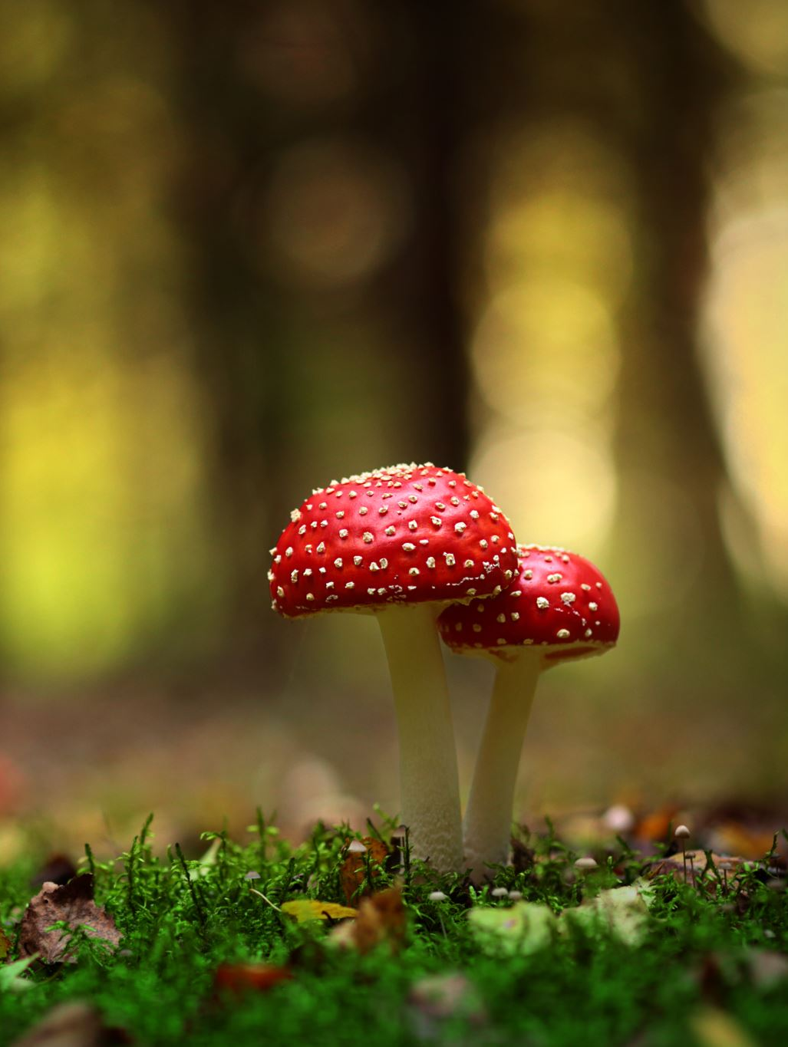
Objectives
Identify Indicative Characteristics: The primary objective is to determine which characteristics strongly correlate with a mushroom's edibility. By analyzing the dataset, we will identify the features (e.g., odor, cap color, veil color, habitat) that have the largest impact on a mushroom being poisonous or edible.
Assess the Significance of Notable Features: We will investigate whether certain features, such as odor, cap color, veil color, and habitat, provide significant indications of a mushroom's edibility. This analysis will shed light on the most noticeable characteristics that play a key role in classifying mushrooms.
Odor - A Key Indicator: We will specifically focus on the attribute "Odor" to understand its role as a potential indicator of a mushroom's toxicity. This exploration will provide insights into whether the smell of a mushroom can offer reliable clues about its edibility.
Cap Color, Veil Color, and Habitat: In addition to odor, we will also examine the attributes "Cap Color," "Veil Color," and "Habitat" to assess their significance in differentiating edible and poisonous mushrooms. Understanding the impact of these attributes can enhance our ability to make informed decisions when encountering mushrooms in various environments.
Machine Learning Model Evaluation: We will employ machine learning models, including logistic regression, naive Bayes, and neural networks, to predict the edibility of mushrooms based on the dataset's attributes. The models' accuracy will be evaluated to determine their effectiveness in correctly classifying mushrooms.

Slide 4
Approach
Data Exploration and Feature Analysis: We will perform exploratory data analysis on the mushroom dataset to gain insights into the characteristics of mushrooms. This step involves data preprocessing, handling categorical variables, and understanding the distribution of the target variable (edibility).
Feature Importance: Using statistical methods and machine learning algorithms, we will determine the most important features that influence a mushroom's edibility. This analysis will unveil the attributes that are strong indicators of whether a mushroom is poisonous or edible.
Odor as a Key Indicator: We will specifically investigate the attribute "Odor" to assess its significance in predicting a mushroom's edibility. This will involve visualizations and statistical tests to understand the relationship between different odors and mushroom toxicity.
Cap Color, Veil Color, and Habitat Analysis: We will also examine the attributes "Cap Color," "Veil Color," and "Habitat" to evaluate their impact on a mushroom's edibility. This will provide valuable insights into the importance of these characteristics in classifying mushrooms.
Machine Learning Model Evaluation: We will implement machine learning models, including logistic regression, naive Bayes, and neural networks, to classify mushrooms based on their attributes. The models will be trained and tested using appropriate evaluation metrics to gauge their accuracy in predicting mushroom edibility.

Slide 5
Hypothesis
Null Hypothesis (H₀):
There is no significant association between the attributes (odor, cap-color, veil-color, and habitat) and the edibility of mushrooms. In other words, these attributes do not provide any useful information to distinguish between poisonous and edible mushrooms.
Alternative Hypothesis (H_{A}):
There is a significant association between at least one of the attributes (odor, cap-color, veil-color, and habitat) and the edibility of mushrooms. At least one of these attributes can be used as a predictor for distinguishing between poisonous and edible mushrooms.

Slide 6

Program Design
This analysis will implement a program that takes a mushroom dataset and outputs a prediction of edible versus poisonous
The program will be implemented using Python and Jupyter notebook accompanied by the matplotlib, numpy, pandas, scikit-learn, seaborn, and tensorflow libraries.
The following steps will occur:
Acquire – Identify the dataset
Prepare – Perform any necessary pre-processing and exploratory data analysis
Analyze – Implement analytical techniques and create models
Report – Properly interpret and define results
Act - Application of results, comparison of results to null hypothesis

Slide 7
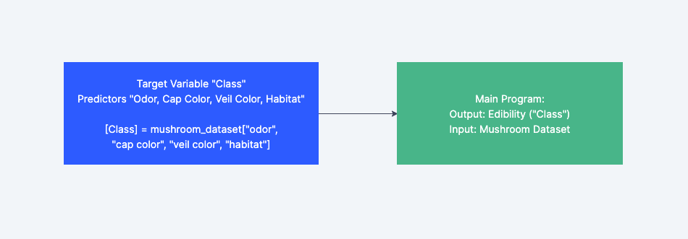
Hierarchy

Slide 8
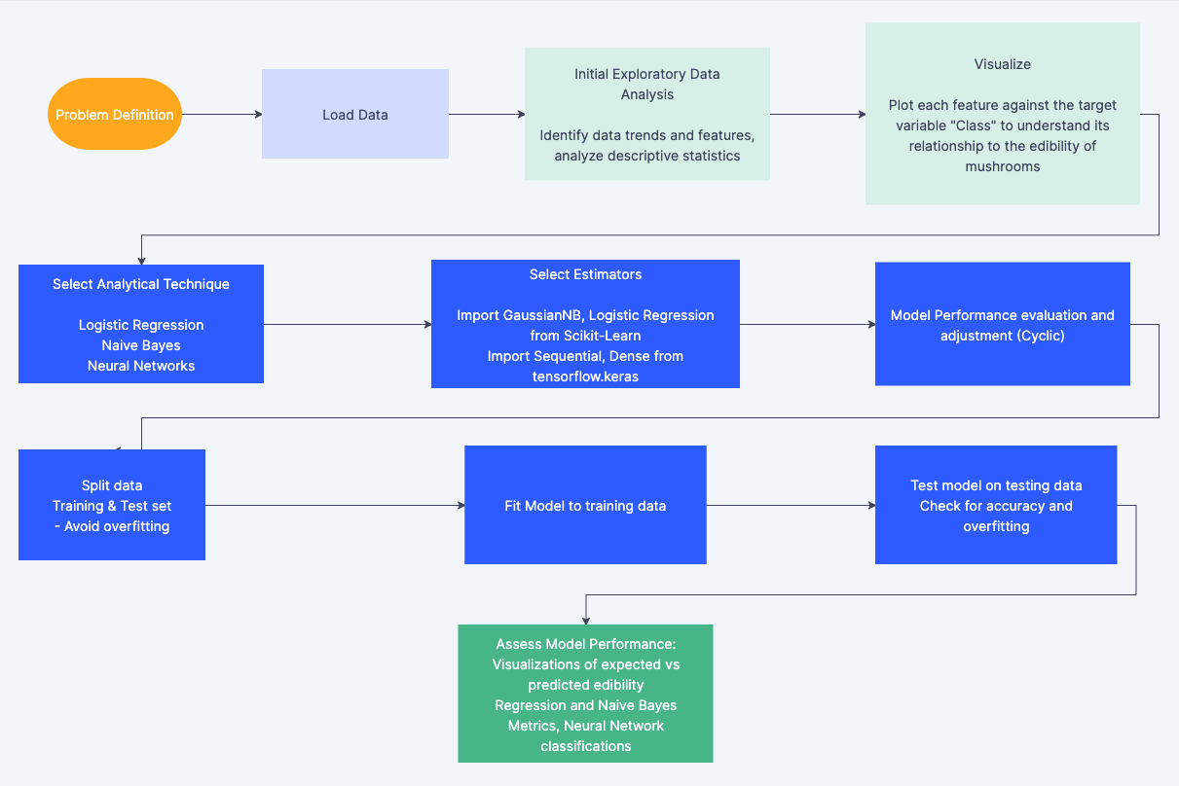
Legend (Colored):
Step 1 – Acquire
Step 2 – Prepare
Step 3 – Analyze + Assess Model
* Steps 4 and 5 (Report/Act) not shown and discussed later

Slide 9

Mushroom Data Card (Target/Predictors Only)
class: Edibility of the mushroom
e: Edible
p: Poisonous
cap-color: Color of the cap
n: Brown
b: Buff
c: Cinnamon
g: Gray
r: Green
p: Pink
u: Purple
e: Red
w: White
y: Yellow
odor: Odor of the mushroom
a: Almond
l: Anise
c: Creosote
y: Fishy
f: Foul
m: Musty
n: None
p: Pungent
s: Spicy
veil-color: Color of the veil
n: Brown
o: Orange
w: White
y: Yellow
habitat: Habitat of mushrooms
g: Grasses
l: Leaves
m: Meadows
p: Paths
u: Urban
w: Waste
d: Woods

Slide 10

Pseudocode
# Load the mushroom dataset from Kaggle
mushroom_dataset = LoadDataset('https://www.kaggle.com/datasets/vallabhadattap/mushroom-classification’)
# Explore and preprocess the mushroom dataset
PreprocessData(mushroom_dataset)
# Split the dataset into features (X) and target (y)
X, y = SplitFeaturesAndTarget(mushroom_dataset)
# Convert categorical attributes to numerical using LabelEncoder
X_encoded = EncodeCategoricalFeatures(X)
# Split data into training and testing sets
X_train, X_test, y_train, y_test = SplitTrainAndTestSets(X_encoded, y)
# Create and train the Naive Bayes classifier
nb_classifier = TrainNaiveBayesClassifier(X_train, y_train)

Slide 11
Pseudocode (Cont)
# Make predictions on the test set using Naive Bayes
y_pred_nb = PredictWithNaiveBayes(nb_classifier, X_test)
# Evaluate the Naive Bayes model
accuracy_nb = CalculateAccuracy(y_test, y_pred_nb)
classification_report_nb = GenerateClassificationReport(y_test, y_pred_nb)
# Create and train the Neural Network model
nn_model = TrainNeuralNetwork(X_train, y_train)
# Make predictions on the test set using Neural Network
y_pred_nn = PredictWithNeuralNetwork(nn_model, X_test)
# Evaluate the Neural Network model
accuracy_nn = CalculateAccuracy(y_test, y_pred_nn)
classification_report_nn = GenerateClassificationReport(y_test, y_pred_nn)
# Compare and present the results
PresentResults(accuracy_nb, classification_report_nb, accuracy_nn, classification_report_nn)

Slide 12
Step 1: Acquire
The mushroom dataset used in this data analysis was acquired from Kaggle.com, a prominent platform for data scientists, machine learning practitioners, engineers, and researchers to access and share datasets. The dataset contains detailed information about various attributes of mushrooms, including odor, cap color, veil color, and habitat. The target variable in the dataset, labeled as 'class,' indicates whether a mushroom is poisonous or edible.
Data Source: https://www.kaggle.com/datasets/uciml/mushroom-classification
The primary objective of this analysis is to explore the relationships between different attributes and the edibility of mushrooms. By studying this dataset, we aim to identify the characteristics that significantly contribute to determining whether a mushroom is poisonous or safe for consumption. Accurate identification of edible and poisonous mushrooms is crucial, as ingesting toxic mushrooms can lead to severe health consequences, including hallucinations and even fatality.

Slide 13
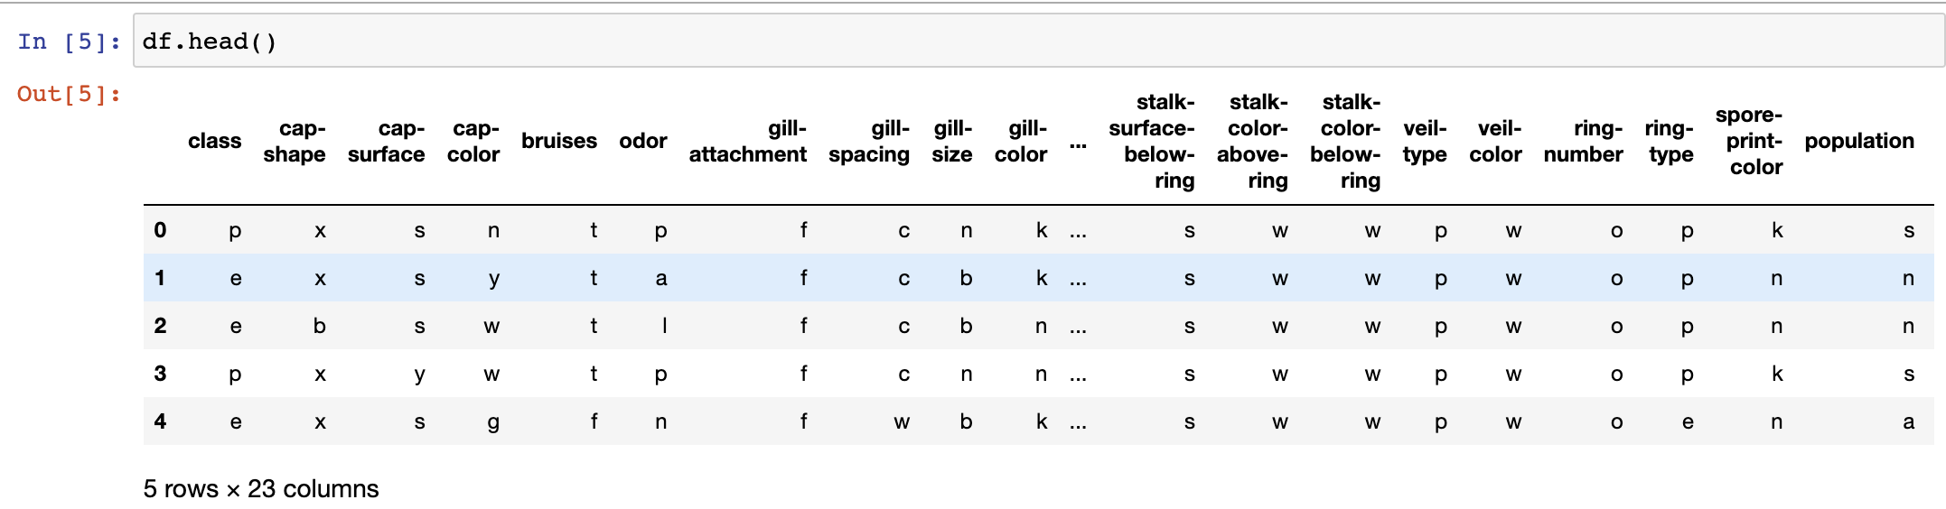
Step 2: Prepare
Using Jupyter Notebook, exploratory data analysis (EDA) will be conducted, and any notable characteristics of the data will be noted and corrected to maintain the integrity of the analysis.
The pandas head() function shows the first 5 rows with no immediately obvious discrepancies and shows the dataset contains 23 variables

Slide 14
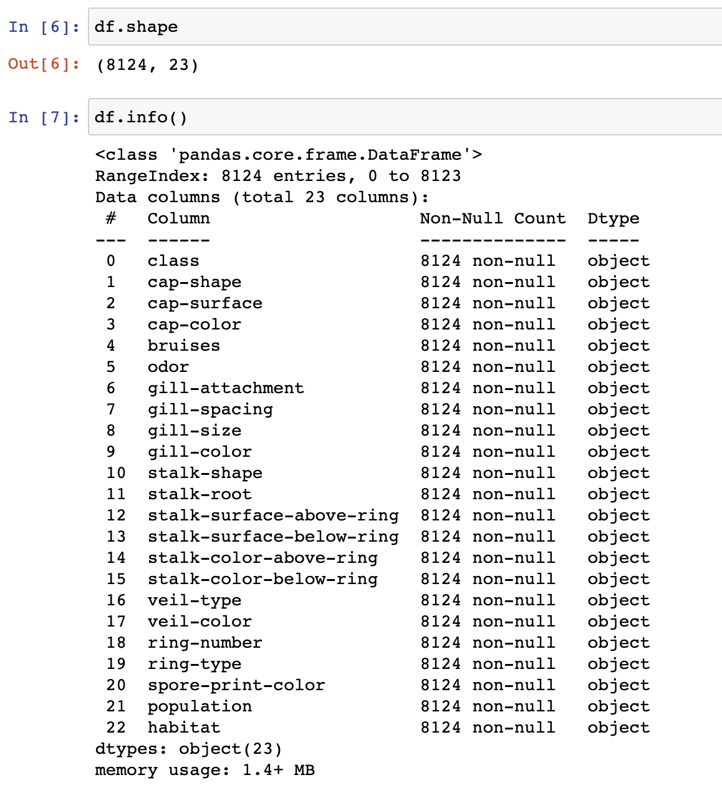
Prepare – Dataframe information
The dataframe contains 8,124 observations
All 23 variables are listed
All variables are categorical and categorized by letters respective to each column (letters are not ordinal or uniform across the data)

Slide 15
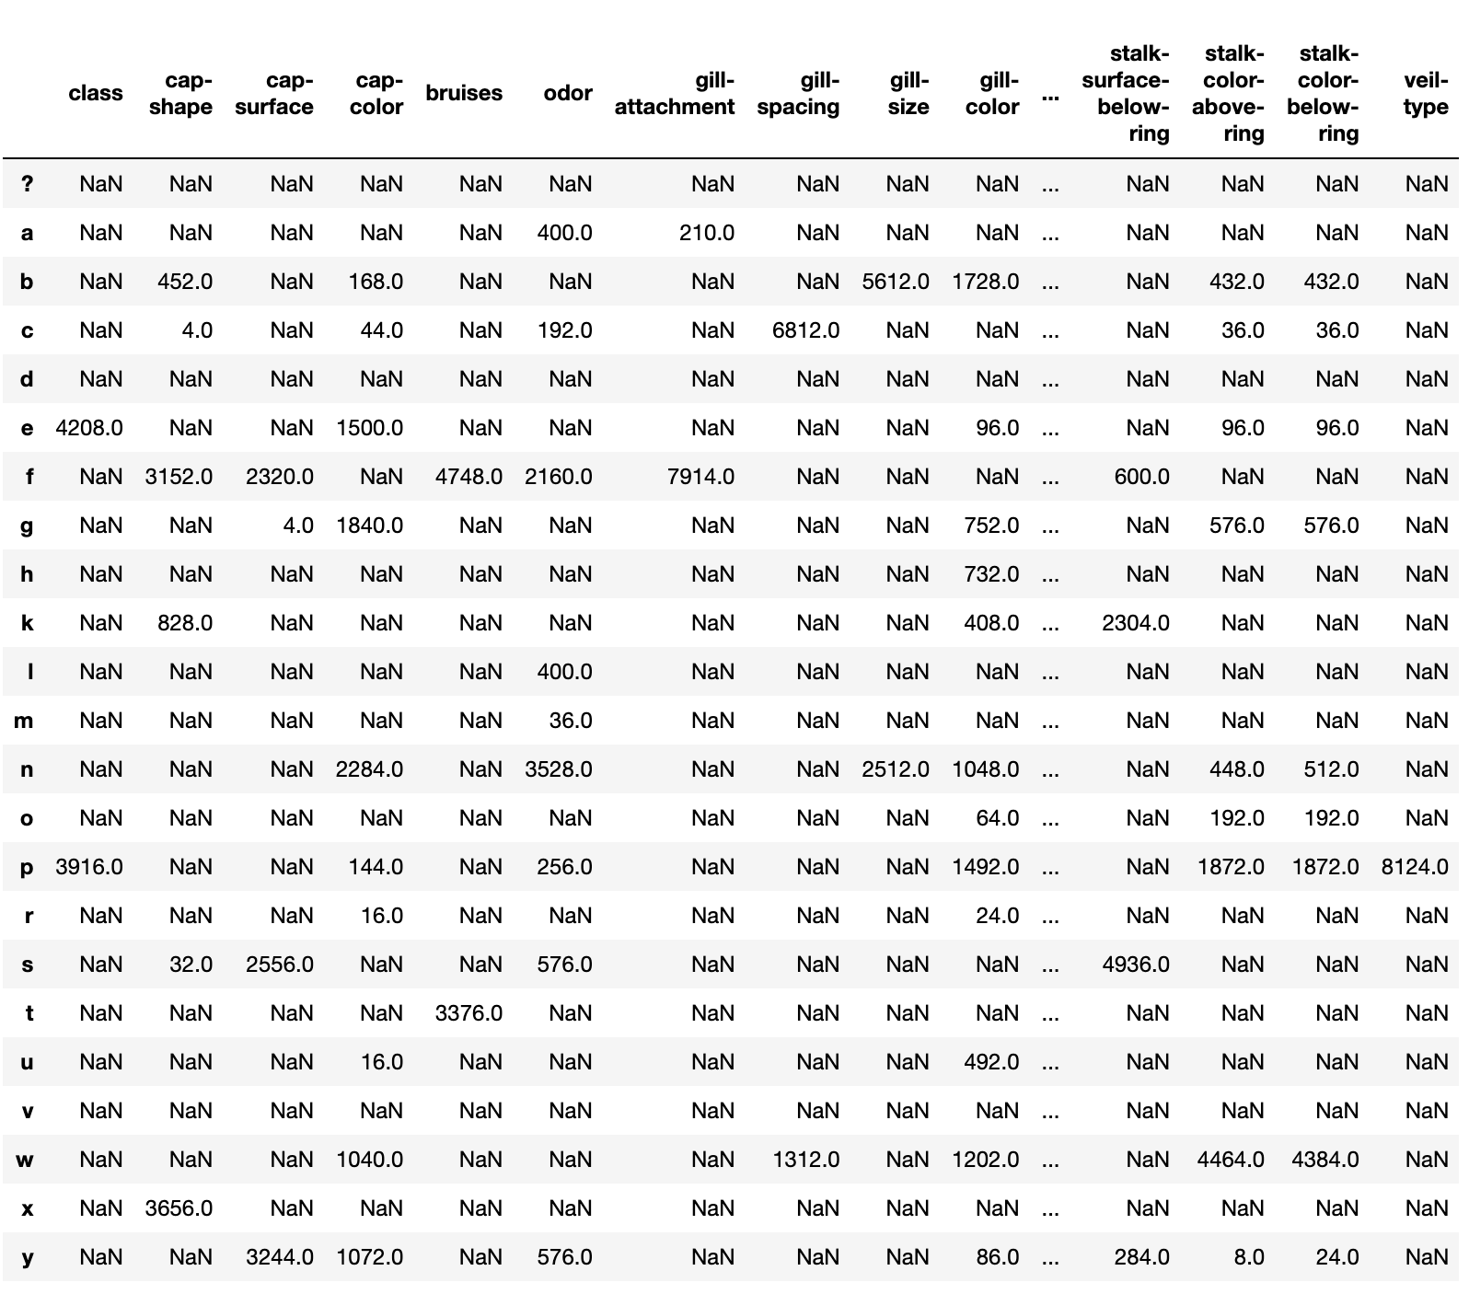
Prepare – Categorical Values
This is a merged dataset containing all possible categorical values a variable can take
Some appear to be ordinal alphabetic, others are intuitive.
Example – The class variable only contains values for “e” and “p” which stand for edible and poisonous, respectively.
It may be necessary to create dummy variables

Slide 16
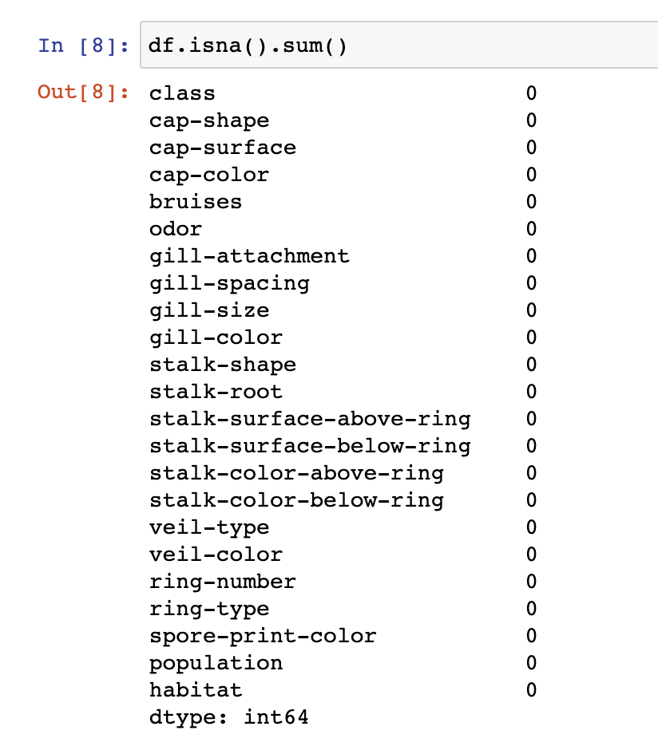
Prepare – Data Integrity
The dataset contains no missing values for any variable, suggesting high data integrity
There may be categorical imbalances in any of the variables, which could specify the need for certain classification algorithms

Slide 17
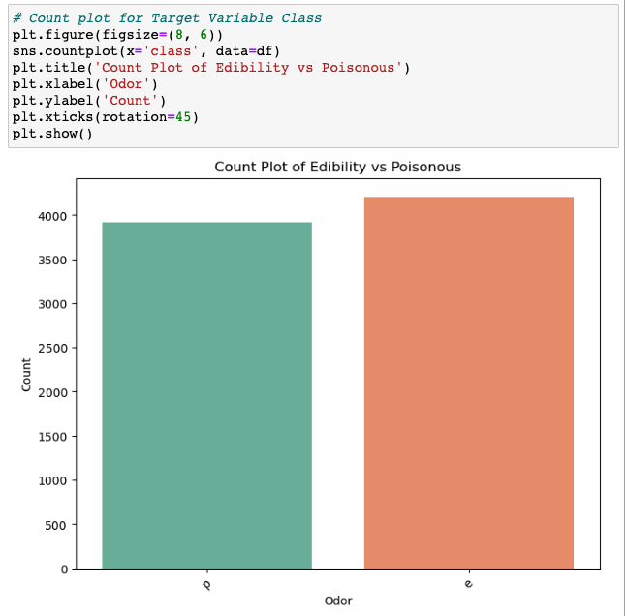
Prepare – Target Variable Distribution
The target variable is mostly even, slightly favoring the presence edible mushrooms
The imbalance is minimal, meaning weights may not need to be assigned

Slide 18
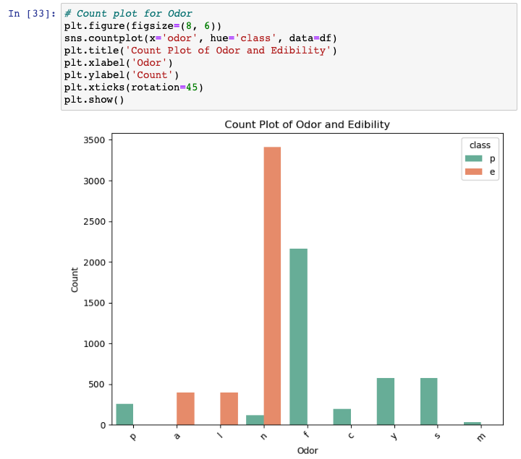
Prepare – Odor vs Edibility
There appear to be patterns where certain odors are more correlated to poisonous and edible mushrooms
The data is dominated by odor categories “n” and “f” where “n” means no odor and “f” means foul.

Slide 19
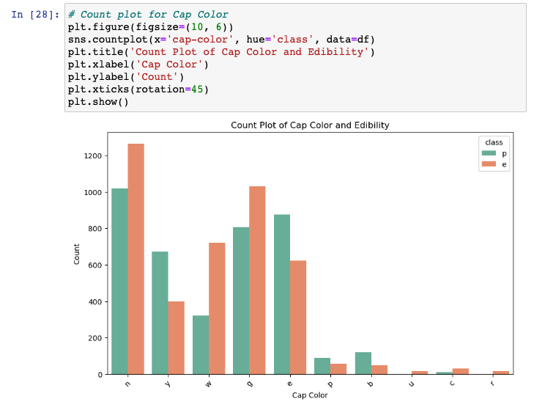
Prepare – Cap Color vs Edibility
Most mushrooms are brown (“n” category) and gray (“g” category).
Some colors such as green (“r” category) and a few others are hardly present.
Colors appear to alternate in having more edible or poisonous mushrooms from left to right and are not entirely dominated by one category (no/minimal correlation?)

Slide 20
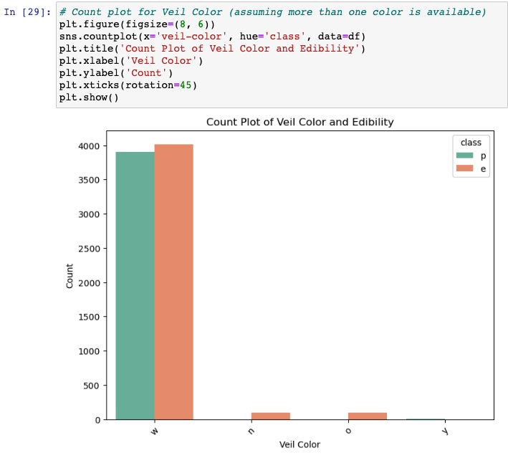
Prepare - Veil Color and Edibility
Almost every veil is white (“w”)
Suspect that this variable may not be useful in classification
Another variable may be selected

Slide 21
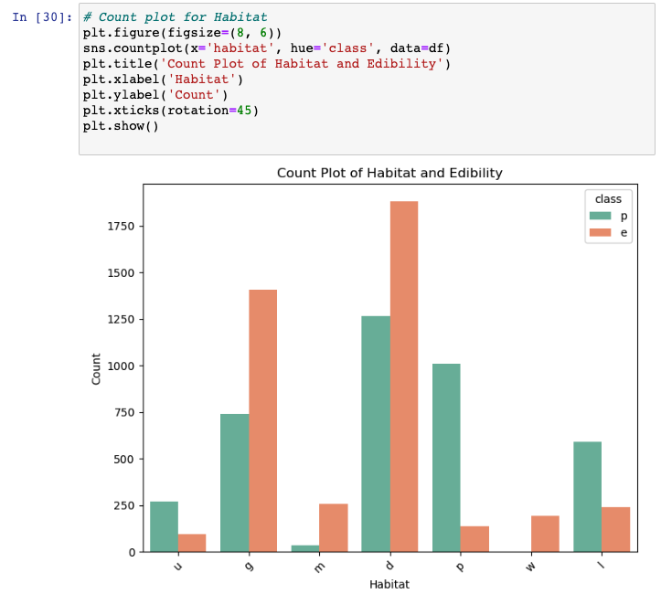
Prepare – Habitat vs Edibility
Every habitat appears to have a dominant class
Categories “g”, “m”, and “d” (grasses, meadows and woods) show more edible mushrooms.
Category “w” Waste shows no poisonous mushrooms
All other habitats are dominated by poisonous mushrooms

Slide 22
Prepare – Preliminary EDA results
The target variable is nearly balanced
All variables are categorical
There are no missing values
Some of the chosen predictor variables hint at no correlation to the target variable
They may be swapped for other variables
The possibility of creating dummy variables exists to allow more statistical analysis and algorithms

Slide 23
Step 3 Analyze – Model Building
Logistic Regression: A Logistic Regression model was built using scikit-learn's LogisticRegression class. The model was trained on the preprocessed data with encoded categorical attributes and one-hot encoding.
Naive Bayes: A Naive Bayes model was constructed using the Gaussian Naive Bayes algorithm from scikit-learn's GaussianNB class. The original encoded categorical attributes were used without one-hot encoding.
The variables are categorical and nominal, making them ideal for dummy variables in Logistic Regression.

Slide 24
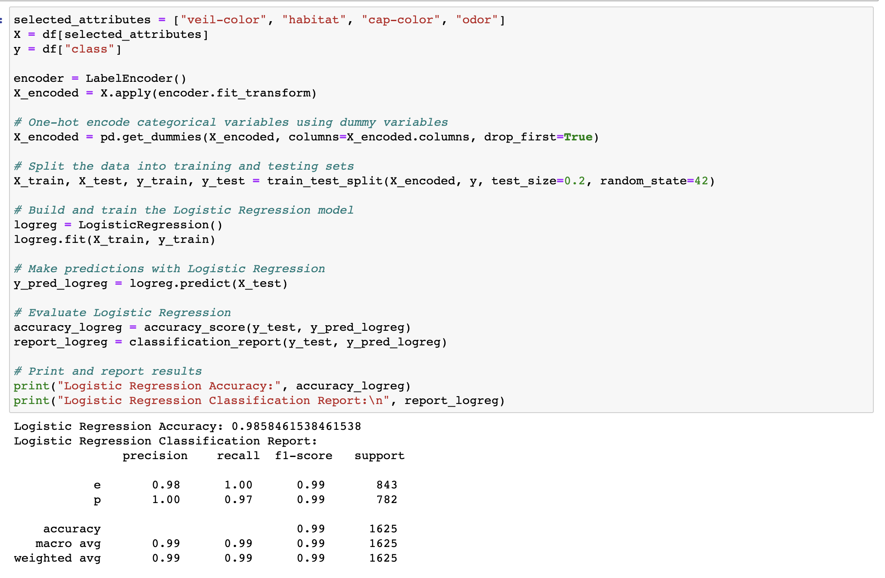
Analyze – Logistic Regression
Logistic Regression performed extremely well.
The data was split into training and test sets, as well as turned into dummy variables due to variables being categorical and nominal.
Detailed results are discussed in the reporting section (step 4)

Slide 25
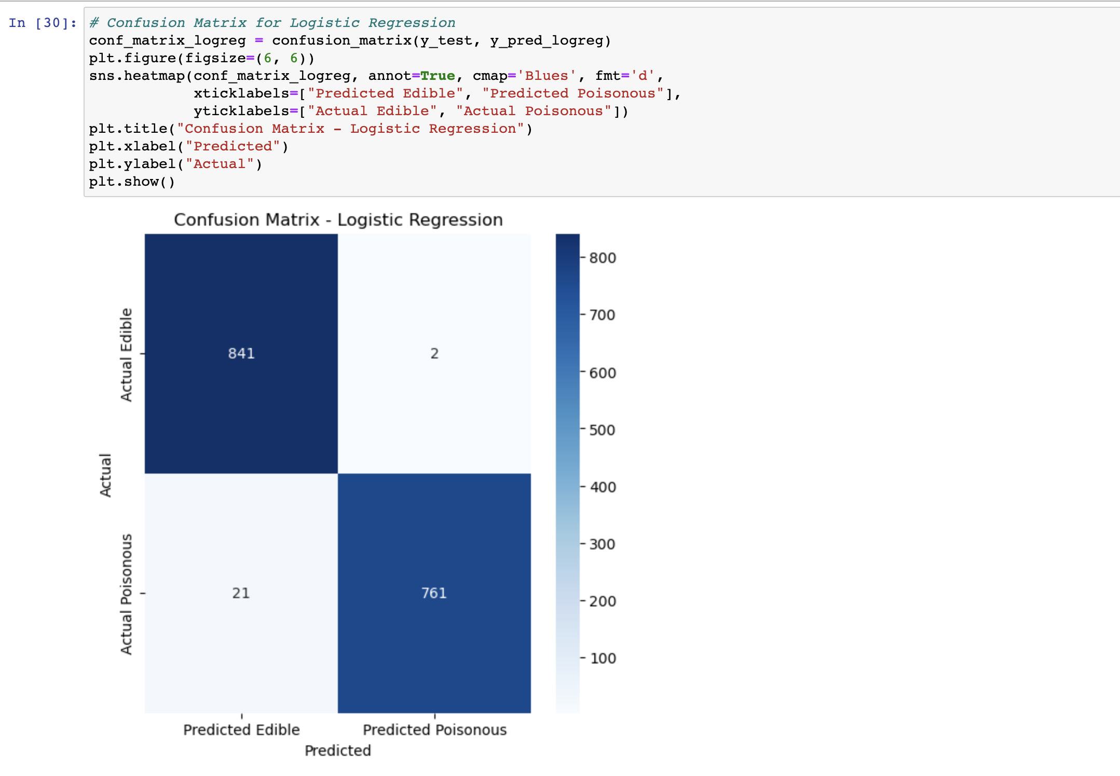
Analyze – Logistic Regression Confusion Matrix

Slide 26
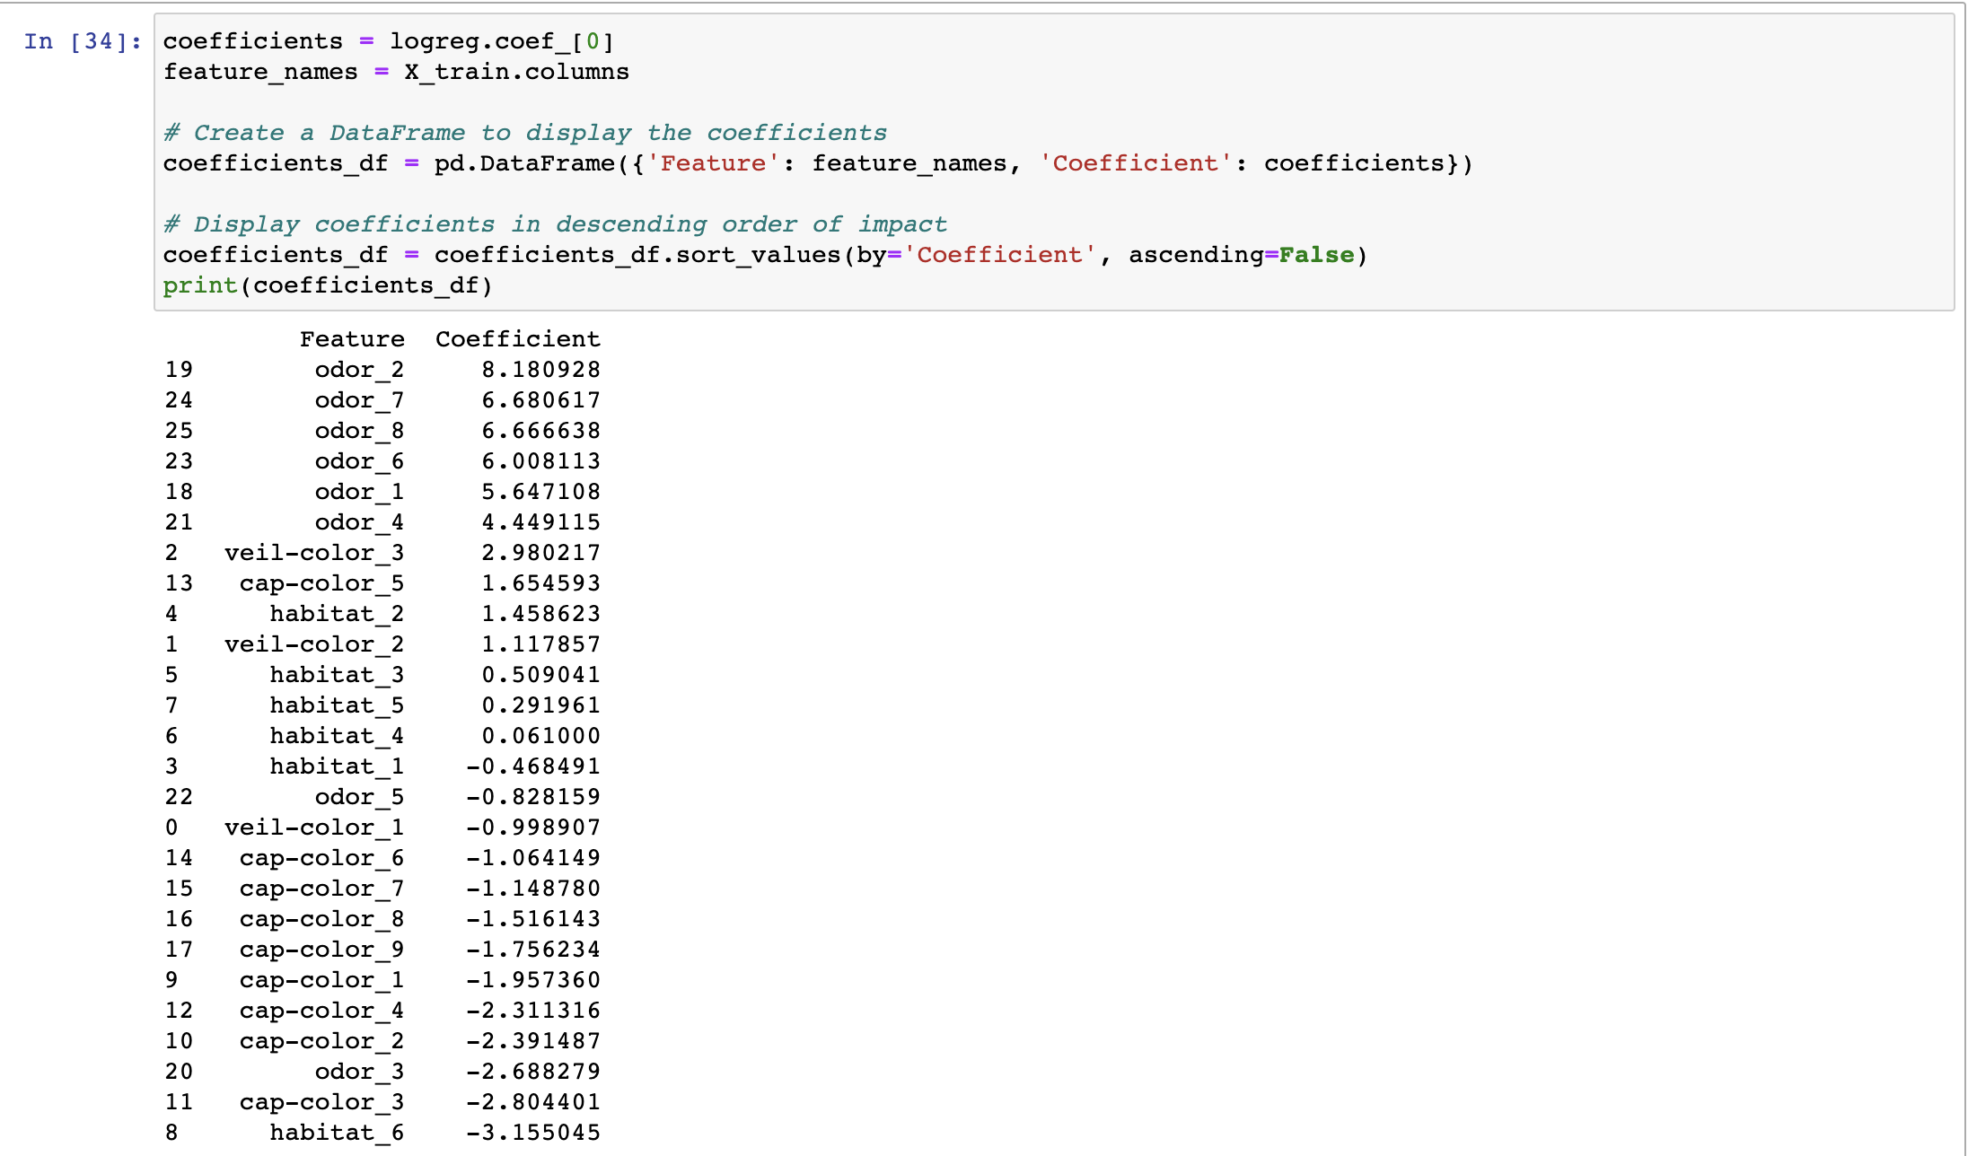
Analyze – Logistic Regression Coefficients
Overview of which dummy variables had the greatest regression coefficient to predict the edibility of mushrooms.
Odor appeared to dominate the prediction

Slide 27
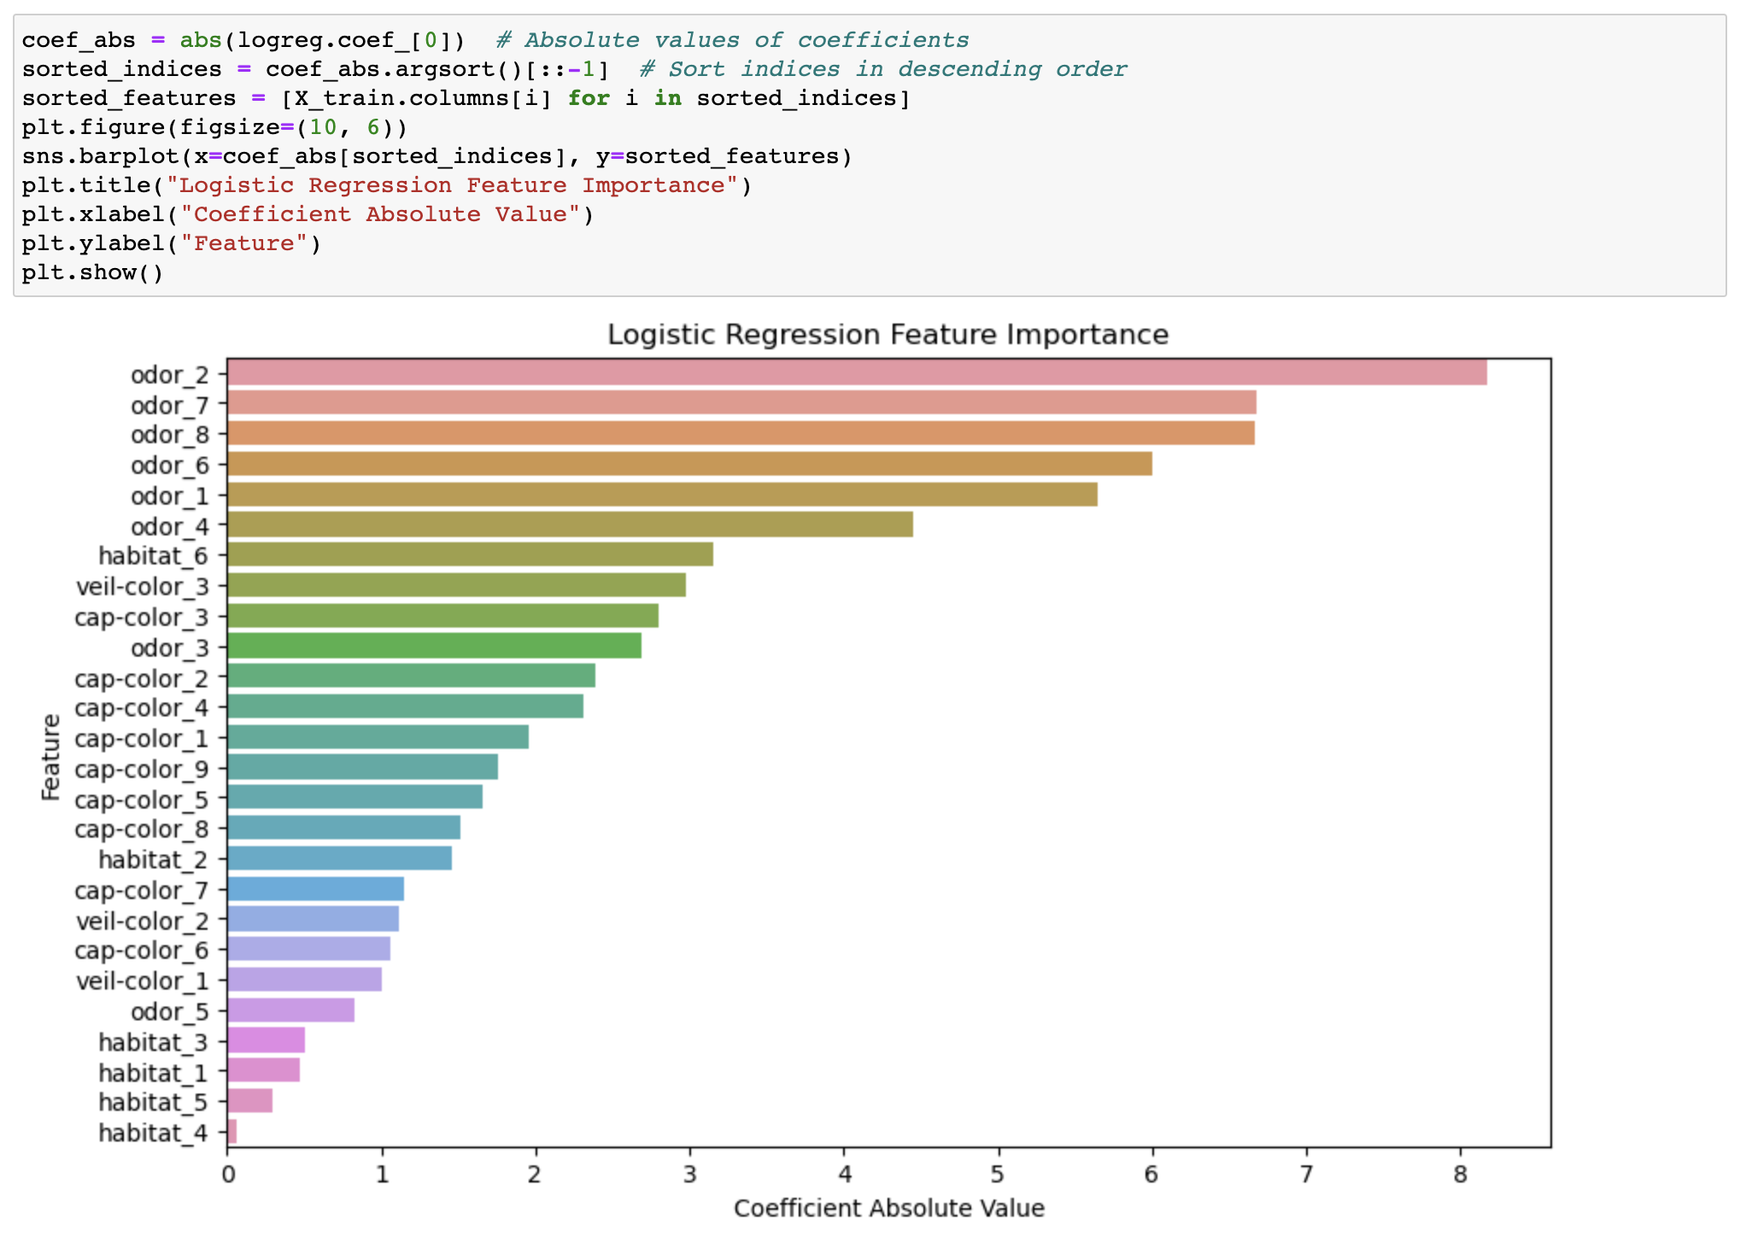
Analyze – Logistic Regression Coefficients

Slide 28
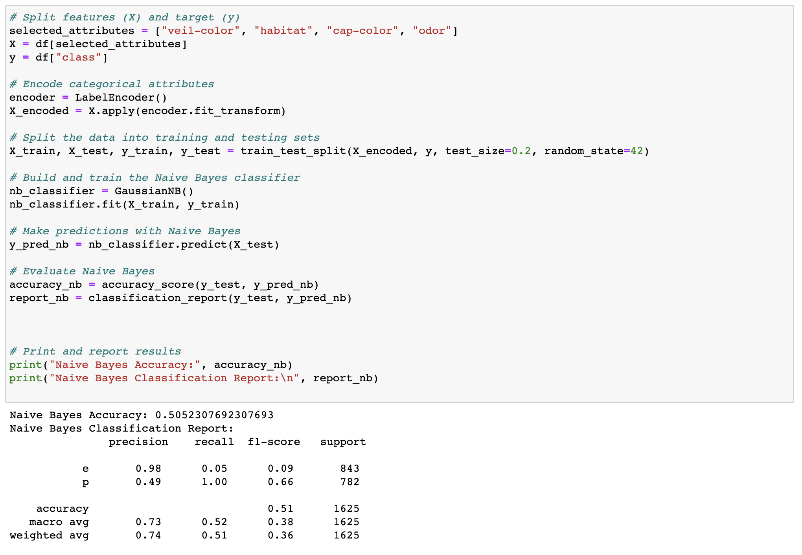
Analyze – Naïve Bayes
Performed significantly worse than logistic regression.
Many imbalanced predictions.
The confusion matrix (next slide) shows clear errors in model prediction.
Due to inaccuracy, visualizations are not provided as they add little value to analyze

Slide 29
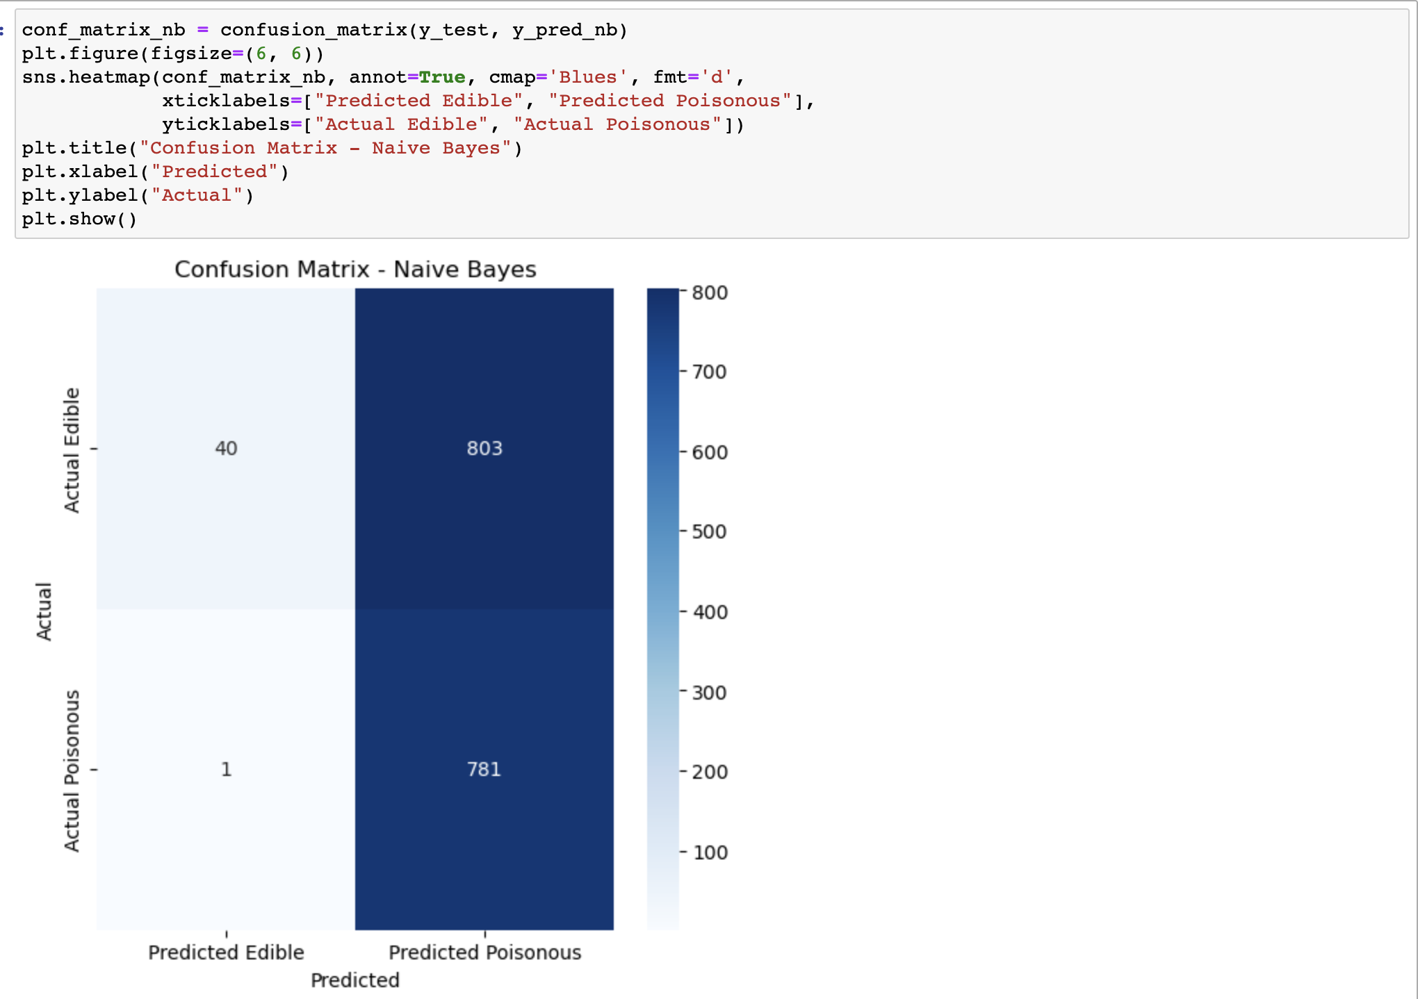
Analyze – Confusion Matrix for Naïve Bayes

Slide 30
Analyze – Additional Algorithms
To compare results, support vector machines (SVM) and Random Forest algorithms are implemented on the mushroom data set.
Cross Validation and other techniques are implemented to avoid any accidental overfitting.
The better performing algorithm (Logistic Regression) has been re-implemented with overfitting prevention techniques to enhance model credibility.

Slide 31
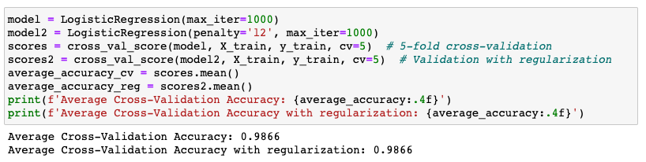
Analyze – Logistic Regression Revisited
Logistic regression is implemented once more on the mushroom dataset using cross validation to reduce the possibility of overfitting. Additionally, another model is created with both cross validation and regularization to reduce any “noise” in the data.
Logistic Regression still has outstanding results.

Slide 32
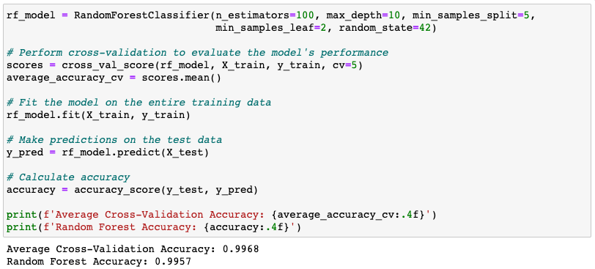
Analyze – Random Forests
Random Forests is another algorithm that helps reduce overfitting issues and is more resistant to noise in the data.
Works well with continuous and categorical data
Contains a built in mechanism to define feature importance
Highly accurate and flexible due to aggregating multiple individual models
This algorithm performed extraordinarily well on the mushroom classification problem

Slide 33
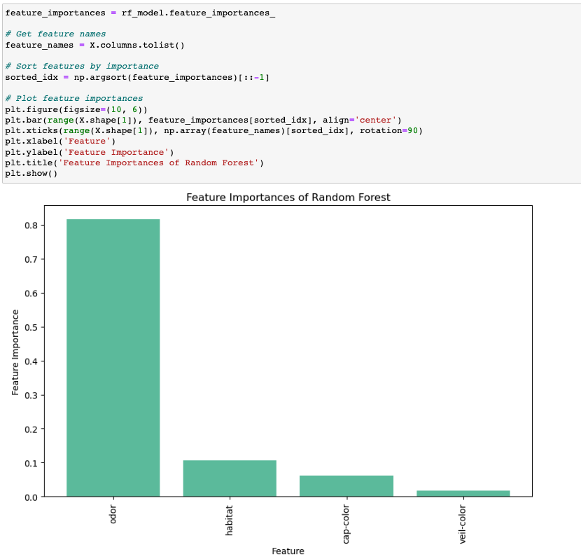
Analyze – Random Forests Feature Importance
Odor is still by far the most important feature.

Slide 34
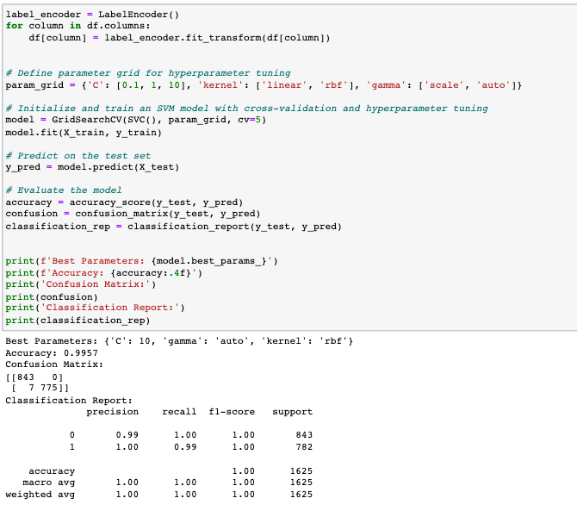
Analyze – Support Vector Model
The final algorithm tested for this part of the project is support vector modeling (SVM).
There are many strengths of SVM, which include but are not limited to: Memory efficiency, interpretability, and being less sensitive to outliers.
Using SVM and cross validation, another highly accurate model is produce when classifying mushrooms.

Slide 35

Analyze – Neural Networks
Implementing neural networks for mushroom classification involves using the power of machine learning to automatically learn complex patterns in the data and make accurate predictions about the edibility of mushrooms. This approach offers several advantages:
Automated Feature Learning: Neural networks can automatically learn features from the raw data, eliminating the need for manual feature engineering. This is particularly useful when dealing with high-dimensional and complex datasets like the mushroom dataset.
Non-Linearity Handling: Neural networks are capable of capturing non-linear relationships between features, allowing them to model intricate decision boundaries that might be difficult for traditional linear models.
Improved Accuracy: Neural networks, when well-tuned, can achieve high levels of accuracy in classification tasks. They can exploit both simple and intricate patterns in the data, leading to better generalization on unseen examples.
Flexibility: Neural networks can handle both structured and unstructured data, making them versatile for various types of datasets.

Slide 36
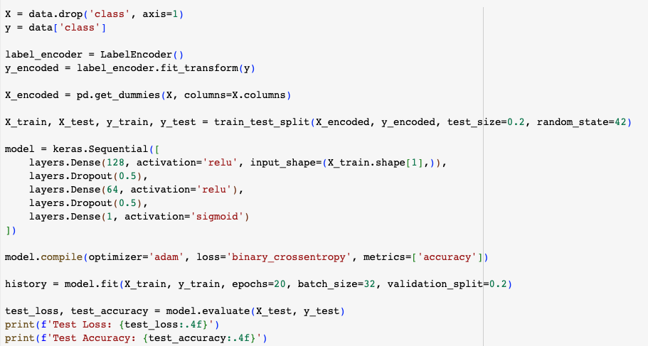
Analyze – Tensorflow/Keras Feedforward Network
The neural network architecture is a type of Feedforward Neural Network (FNN) using the Sequential API
Input Layer: The first layer receives the one-hot encoded features of the mushrooms.
Dense Layers: Two hidden layers with 64 and 32 neurons, respectively, use the ReLU activation function. These layers help the network learn hierarchical features from the data.
Dropout Layers: After each dense layer, a dropout layer is added with a dropout rate of 0.2. This helps prevent overfitting by randomly deactivating a fraction of neurons during training.
Output Layer: The final layer consists of a single neuron with a sigmoid activation function, suitable for binary classification problems like edible/poisonous prediction.

Slide 37
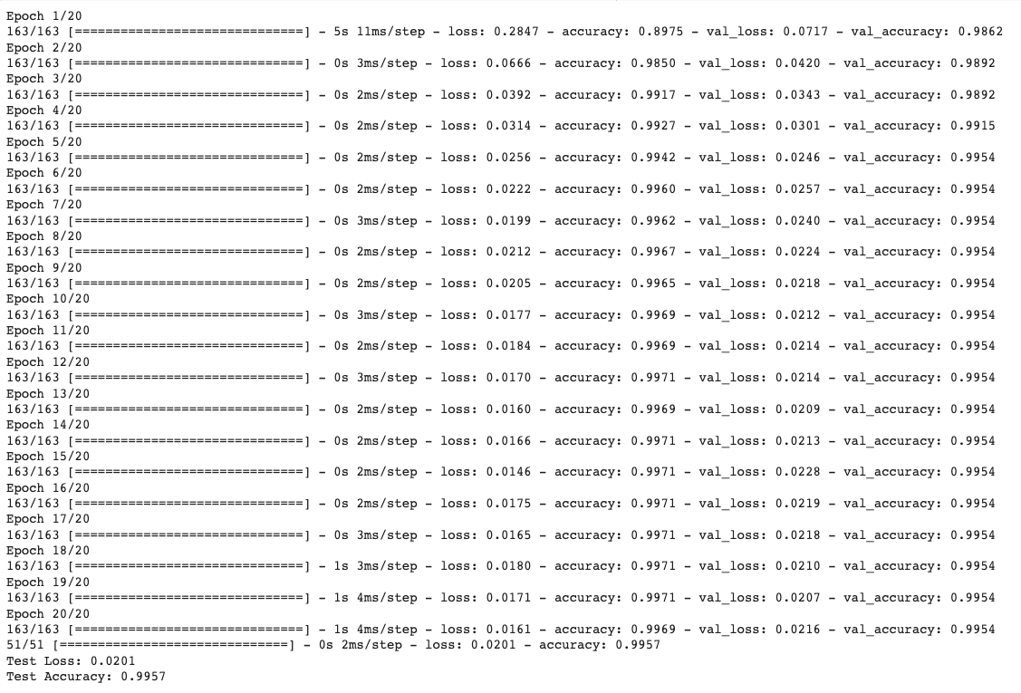
Analyze – Neural Network Results
Using the predictor variables once more, the neural network is quite accurate.
Towards epoch 10, it begins to oscillate between .9971 and .9969
Final accuracy is .9957

Slide 38
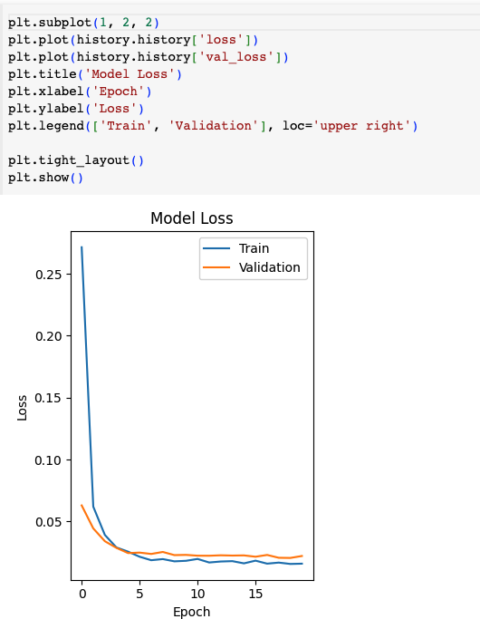
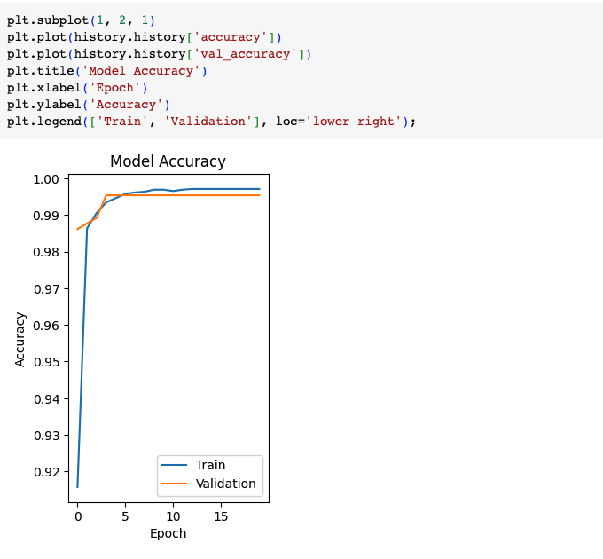
Neural Network Accuracy and Loss
Test Loss (0.0209): Test Loss is a measure of how well the model's predicted values match the actual target values in the test dataset. It quantifies the discrepancy between the predicted values and the true values. In this case, a Test Loss of 0.0209 indicates that, on average, the model's predictions are very close to the true labels in the test data. Lower values of Test Loss indicate better performance, as they signify that the model's predictions are more accurate.
Test Accuracy (0.9957): Test Accuracy is a metric that calculates the proportion of correctly classified examples in the test dataset. It's a measure of how well the model predicts the correct class labels. An accuracy of 0.9957 means that the model correctly predicted the class label for approximately 99.57% of the examples in the test dataset. Higher values of Test Accuracy indicate better performance, as they show that the model is making accurate predictions on new, unseen data.

Slide 39
Step 4: Report
The results of both algorithms provide valuable insights into the classification of mushroom edibility. The Logistic Regression model demonstrates robust performance and provides clarity on the importance of features in the prediction process. This information can aid in identifying key attributes that contribute to a mushroom's classification.
On the other hand, the Naive Bayes model highlights the challenges and nuances of probabilistic classification, especially in the context of imbalanced classes. The focus on class-specific metrics sheds light on where the model excels and where improvements are necessary.
These insights are crucial for developing better strategies for identifying edible and poisonous mushrooms, contributing to safer foraging practices and furthering our understanding of the factors influencing mushroom edibility.

Slide 40
Report - Logistic Regression
Logistic Regression demonstrated exceptional results in classifying the edibility of mushrooms. The accuracy achieved was approximately 98.6%, indicating that the model correctly classified the vast majority of instances in the test set. The classification report provides additional insights into the model's performance. For the "edible" class ('e'), the precision, recall, and F1-score were all at 98%, showcasing that the model is accurate in identifying actual edible mushrooms. Similarly, for the "poisonous" class ('p'), precision was 100%, indicating that when the model predicts a mushroom as poisonous, it is almost always correct. The recall for the "poisonous" class was 97%, indicating the model's ability to capture a large portion of actual poisonous mushrooms.
These results suggest that the Logistic Regression model is highly effective in distinguishing between edible and poisonous mushrooms based on the selected attributes. The model's accuracy, precision, and recall values all point towards a reliable predictive capability.
Logistic Regression maintained it’s accuracy after using cross validation to avoid overfitting.

Slide 41
Report – Naïve Bayes
Naive Bayes, while achieving an accuracy of approximately 50.5%, demonstrated a notably imbalanced performance between the two classes. Precision for the "edible" class was high at 98%, but recall was low at 5%, suggesting that the model correctly classified very few actual edible mushrooms. On the other hand, precision for the "poisonous" class was 49%, indicating that when predicting mushrooms as poisonous, the model was correct roughly half the time. The high recall of 1.00 for the "poisonous" class implies that the model effectively identified actual poisonous mushrooms.
Given the probabilistic nature of Naive Bayes, traditional evaluation metrics such as ROC curves and precision-recall curves might not be as informative in the multiclass setting. Instead, the focus was on class-specific metrics and understanding how well the model identifies specific classes.
The results from Naive Bayes suggest potential limitations in its ability to accurately classify edible mushrooms, particularly due to the low recall for the "edible" class. Further exploration and potential model adjustments could be considered to enhance its performance.

Slide 42
Report – SVM
Support Vector Machines also displayed a high level of accuracy compared to logistic regression and performed much better than Naïve Bayes
This algorithm was implemented with cross validation from the beginning and may have shown an inferior result had it been implemented without it (or it would have overfit).
SVM is an easy to implement and powerful algorithm that can be used for many different analysis problems.
Demonstrated a perfect F-1 score, being just short of perfect recall and precision (0.99)

Slide 43
Report – Random Forests
Random Forests is a more complex algorithm but includes a lot of additional functionality to streamline analytic processes.
Random forest also had nearly perfect accuracy even without cross validation, as it has inherent resistance to overfitting.
Overfitting reduction is caused by training on different subsets of the data (bagging), random feature selection, ensemble averaging, and build in cross-validation.
Every algorithm significantly outperformed Naïve Bayes

Slide 44
Report – Deep Learning Neural Network
The neural network achieved an exceptional Test Loss of 0.0209, signifying its proficiency in making accurate predictions on new data.
A remarkable Test Accuracy of 99.57% was attained, highlighting the model's precision in classifying mushroom samples.
The model's architecture comprised two hidden layers with 64 and 32 units, utilizing ReLU activation and dropout regularization for improved generalization.
The successful implementation of the neural network underscores its capability to generalize from training data and accurately classify previously unseen mushroom samples.

Slide 45
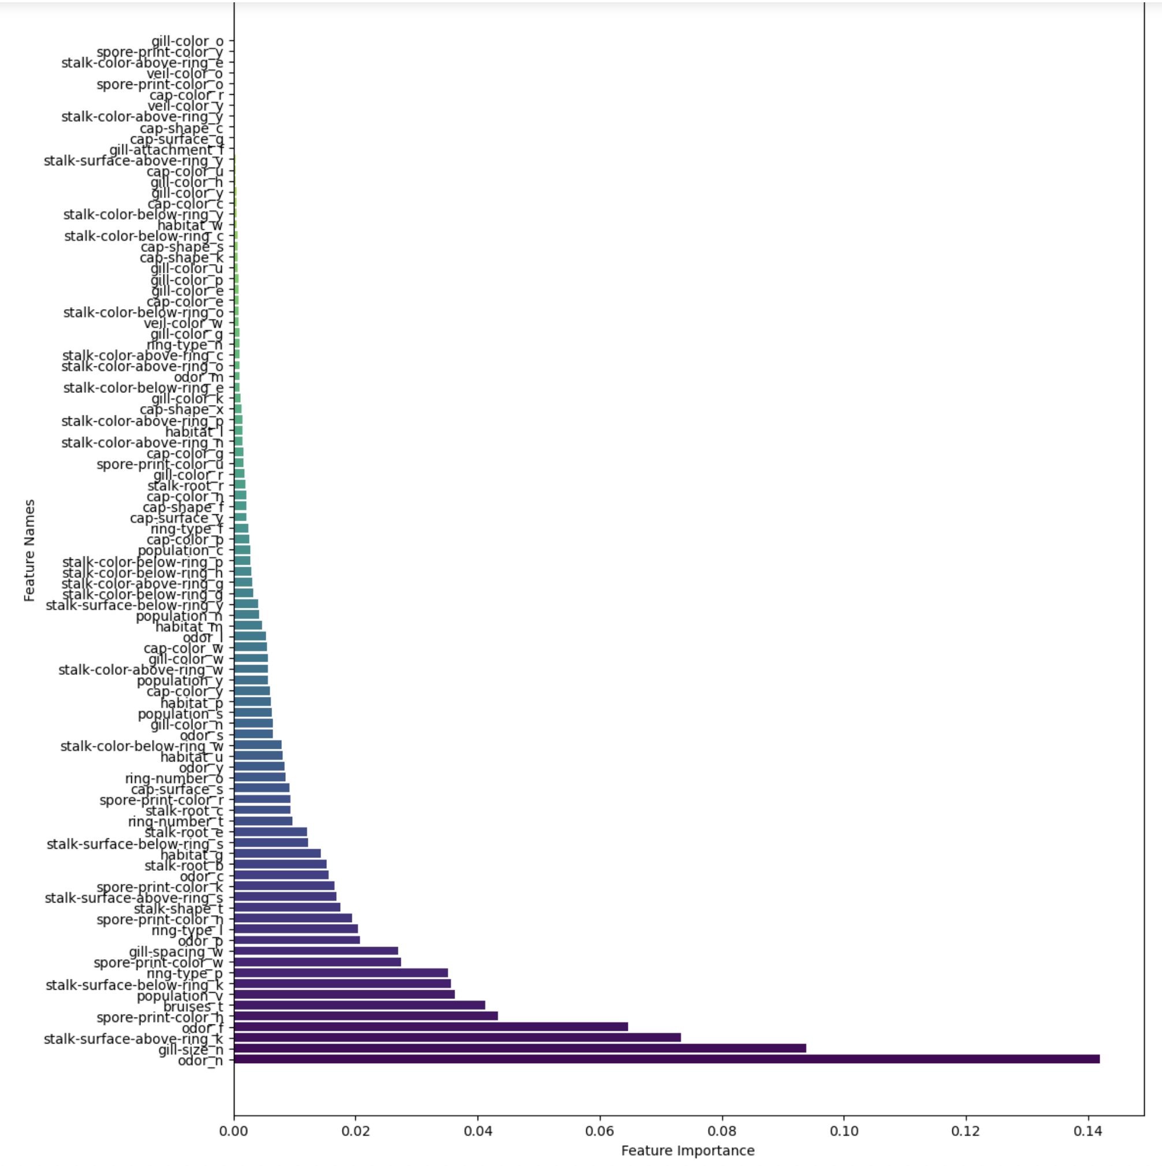
Report - Results
Of the predictor variables, “Odor” dominated in the classification of poisonous vs edible mushrooms.
To compare predictor variable selection versus the entire dataframe, feature importance was analyzed to see if any important variables were not included in the classification algorithms
Odor still largely dominates, where odor of category “n” for “none” being the strongest feature for classification.
Gill size, stalk surface, and bruises were also significant, which was not expected in designing the experiment.

Slide 46
Step 5 - Act
Act: Apply Results and Connect with Problem Statement After conducting a thorough analysis of the mushroom dataset and building predictive models, it’s time to apply the results and connect them with the problem statement of identifying edible and poisonous mushrooms. The insights gained from the analysis provide valuable information for addressing the initial questions and objectives of the study.
Applying Model Predictions: The developed machine learning models, including Logistic Regression, Naïve Bayes, SVM, Decision Trees, and Random Forests, provide predictions about the edibility of mushrooms based on their attributes. These models have been trained on the training data and evaluated using the testing data to ensure their effectiveness.
Utilizing Feature Importance: The feature importance analysis conducted for Random Forests helps us understand which attributes have the most significant impact on predicting whether a mushroom is edible or poisonous. This information can be used to prioritize certain attributes when identifying mushrooms in real-world scenarios.

Slide 47
Act
Connecting with Problem Statement: The results obtained from the models offer insights into the features that are strong indicators of edibility or toxicity. By utilizing these insights, individuals, including foragers and mycologists, can make more informed decisions when identifying mushrooms. This is particularly crucial because misidentifying poisonous mushrooms can have serious health consequences. More attention is brought upon mushrooms and nootropics for their therapeutic and cognitive enhancing properties.
Risk Mitigation and Education: The analysis can contribute to the development of educational resources and tools that help individuals learn about the characteristics of edible and poisonous mushrooms. These resources can aid in raising awareness about the importance of proper identification and the potential risks associated with consuming wild mushrooms.
Further Research and Collaboration: While the developed models provide a good starting point, ongoing research and collaboration within the mycology and data science communities can further refine and improve the accuracy of identification. Additionally, incorporating more data and attributes could enhance the models’ performance.

Slide 48
Act - Conclusion
In conclusion, the “Act” phase involves applying the knowledge gained from the analysis to real-world scenarios. The insights and predictive models can empower individuals to make safer decisions when it comes to identifying and consuming mushrooms. The combination of data science techniques and domain knowledge contributes to addressing the challenge of distinguishing edible and poisonous mushrooms accurately.

Slide 49

End of Micro Project 4

